Slide 1
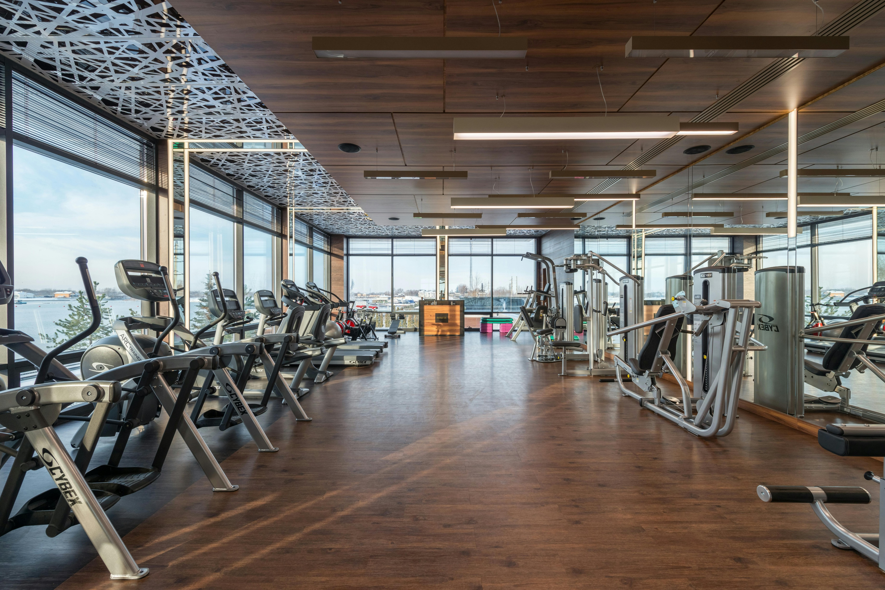
Photo Album
GYM MANAGEMENT SYSTEM
by siddharth rawlo

Slide 2
Contents
Abstract
Introduction
Modules
Requirements
UML Diagrams
Features
Conclusion

Slide 3
Abstract
The Gym Fitness Management System is a web-based application developed using Django (Python), HTML5, CSS, JavaScript, and MySQL, aiming to modernize gym operations by digitizing every manual task. The project provides a centralized platform for administrators, trainers, members, and guests to interact with various gym-related activities efficiently.
The system allows administrators to manage gym memberships, attendance, products, payments, and fitness content, while trainers can create and assign personalized workout schedules and diet plans for members. Members can access these plans, track attendance, shop for gym products, and engage with fitness blogs and videos. Additionally, guests can explore the platform and seamlessly register for gym memberships.
Key functionalities include automated attendance tracking, membership plan management, product purchases, feedback collection, and comprehensive reporting with advanced filters. The database is designed with structured tables to manage users, memberships, workouts, and payments effectively.
By replacing traditional manual methods, this system significantly improves efficiency, reduces operational complexity, and enhances user engagement. The platform’s scalability and user-friendly interface make it a valuable tool for gym owners, trainers, and members, fostering an integrated fitness ecosystem.

Slide 4
Introduction
A Gym Management System (GMS) is a software application designed to streamline and automate the daily operations of a gym or fitness center. It enhances efficiency by managing memberships, payments, class schedules, trainer assignments, and overall facility administration.
Key Features
Membership Management – Tracks member registrations, renewals, and attendance.
Billing & Payments – Automates invoicing, online payments, and subscription plans.
Class & Trainer Scheduling – Organizes workout sessions, personal training appointments, and staff shifts.
Inventory & Equipment Management – Monitors gym equipment availability, usage, and maintenance needs.
Reporting & Analytics – Provides insights into member activity, revenue, and overall performance.
Benefits of a Gym Management System
Efficiency – Reduces manual paperwork and saves time.
Improved Customer Experience – Offers easy online booking and automated reminders.
Financial Tracking – Ensures accurate billing and revenue monitoring.
Data Security – Protects sensitive member information.

Slide 5
Modules
Number of Modules :
Admin Module
The Admin Module is the backbone of the system, providing comprehensive management capabilities for all aspects of the gym's operations. It is designed for the gym owner or staff with administrative privileges.
Trainer Module
The Trainer Module is designed for gym trainers, allowing them to manage members' fitness activities and track their progress.
Member Module
The Member Module focuses on providing gym members with a personalized experience and tools to track their fitness journey.
Guest Module
The Guest Module is for individuals who are not yet members but are exploring the gym's offerings. It allows potential members to interact with the platform to a limited extent.

Slide 6
Requirements
System Configuration Required:
Operating System: Windows/Linux/MacOS
Processor: Intel i3 or higher
RAM: 4GB or above
Storage: 20GB free space
Browser: Chrome, Firefox, or Edge
Software Required:
Frontend: HTML5, CSS 2.1, JavaScript
Backend: Python 3.8 with Django 3.1
Database: MySQL 5.5

Slide 7
UML DIAGRAMS
Class Diagram
ER Diagram
Activity Diagram
Sequence Diagram
Data Flow Diagram
Use Case Diagram

Slide 8
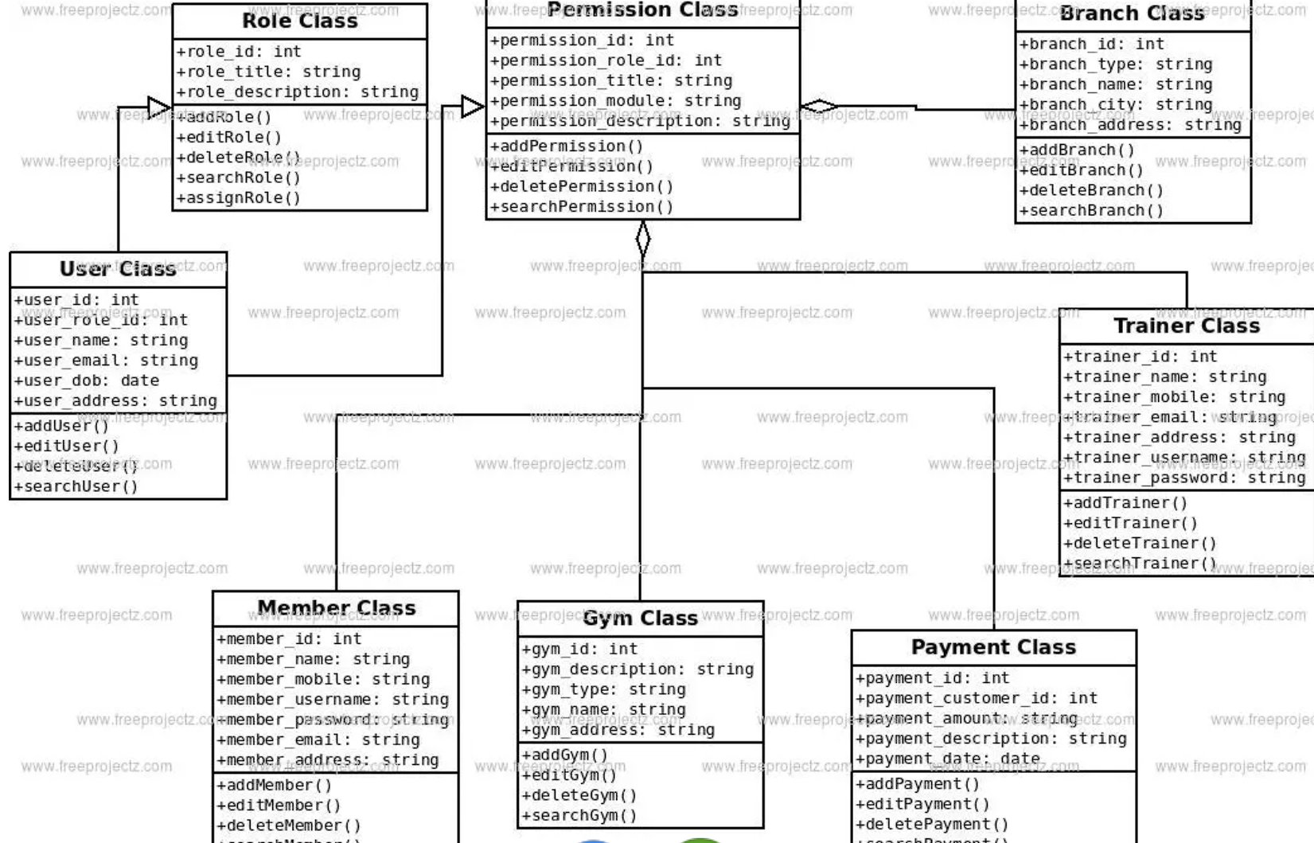
Class Diagram

Slide 9
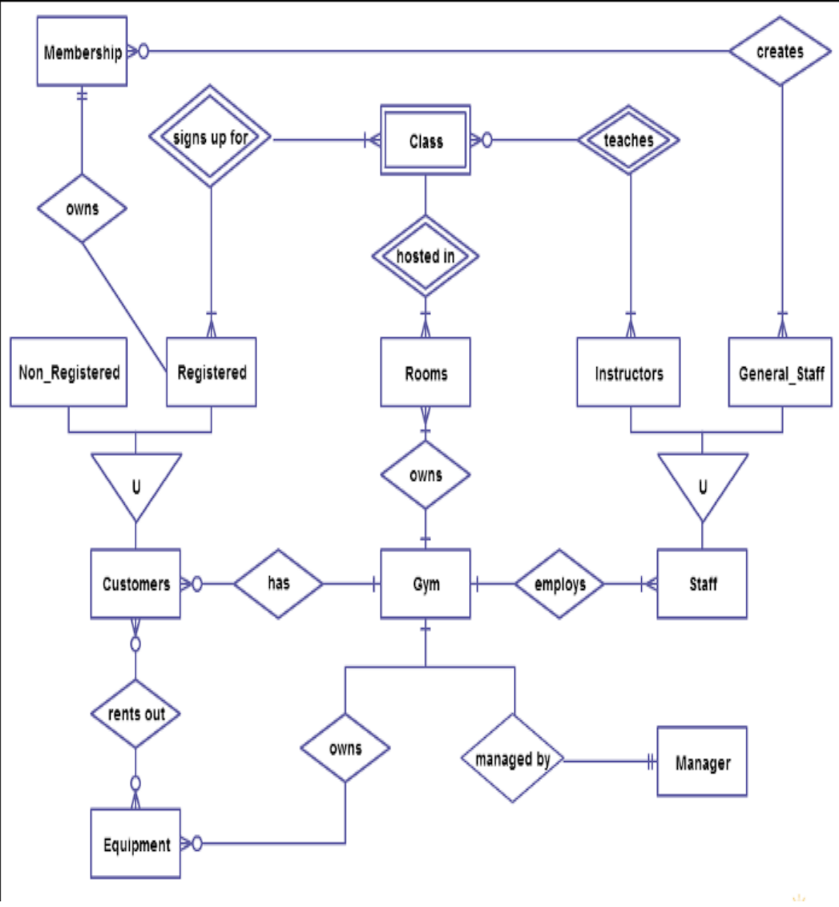
ER Diagram

Slide 10
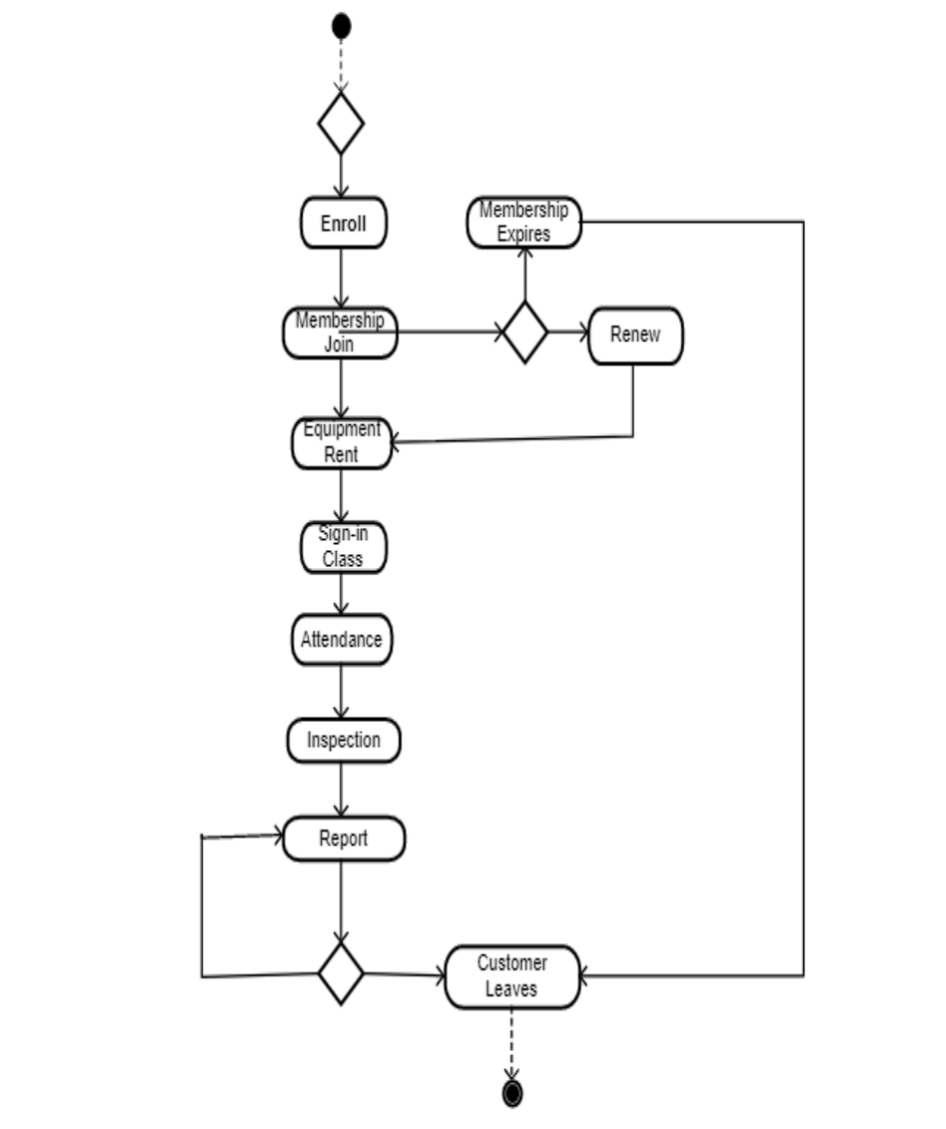
Activity Diagram

Slide 11
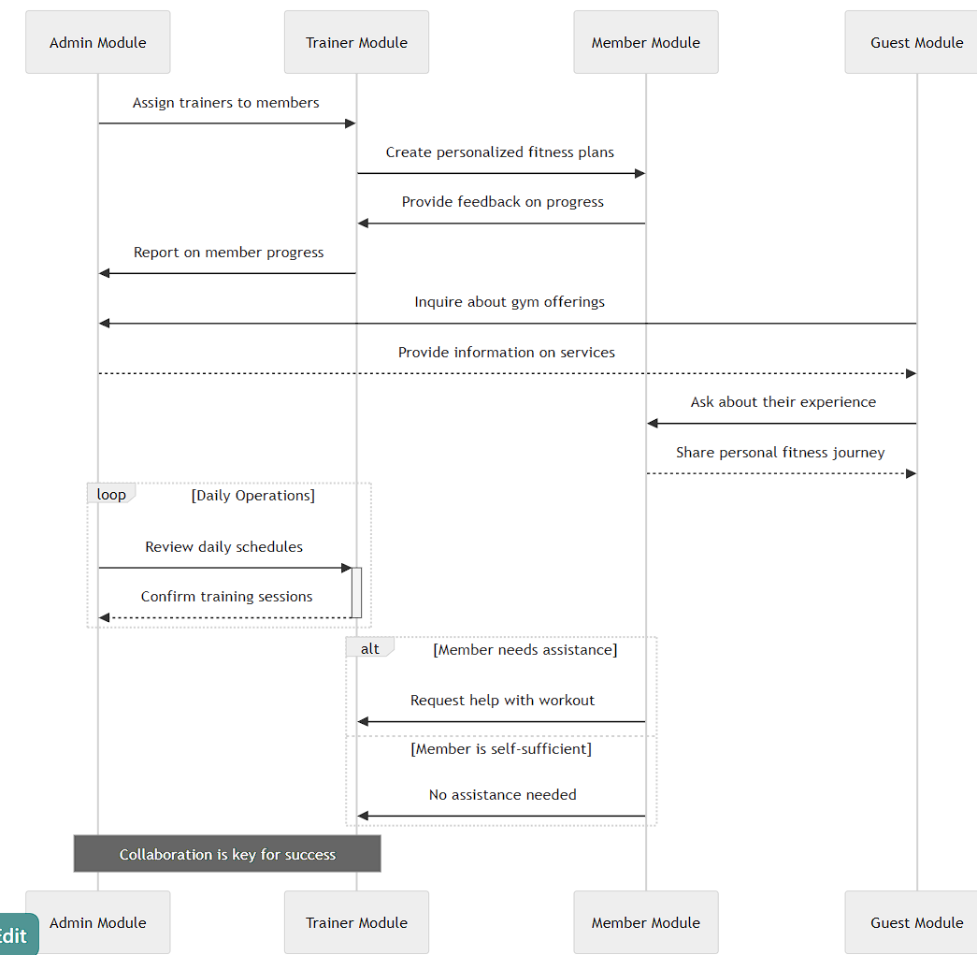
Sequence Diagram

Slide 12
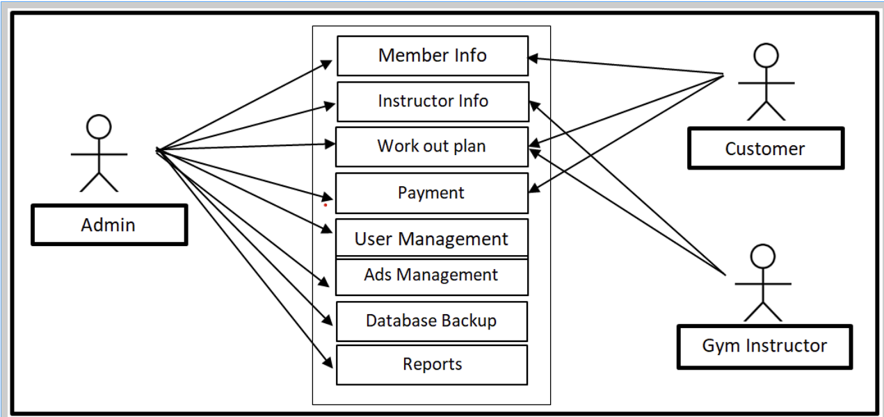
Use Case Diagram

Slide 13
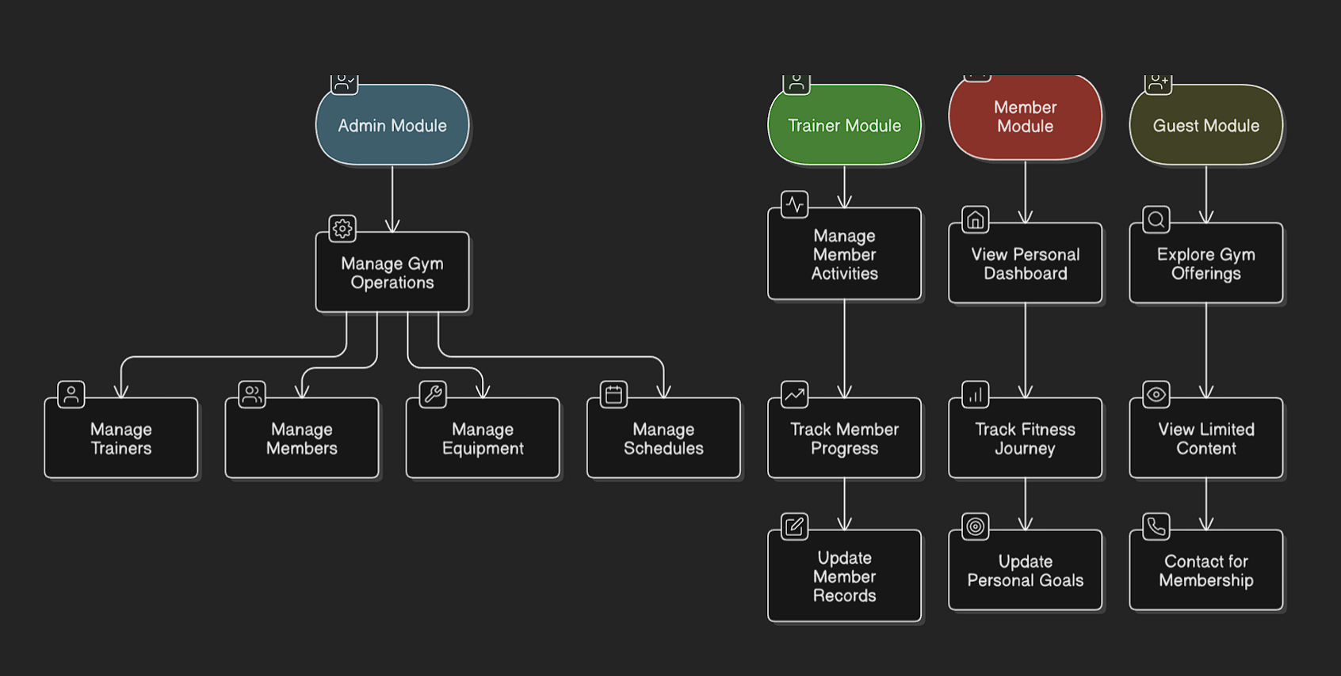
Data Flow Diagram

